Slide 1
CSE 2451 Storage-class Specifiers
Zichen Zhang

Slide 2
Overview
Storage-class specifiers
auto
static
register
extern
Storage duration
auto
static
thread
allocated
Redeclaration
linkage
no linkage
internal linkage
external linkage
Notes:
Source:
https://en.cppreference.com/w/c/language/storage_duration

Slide 3
What is storage-class specifiers
First, what is storage duration? Every object in C has a property called storage duration which limits its lifetime.
Second, what is linkage? Linkage refers to the ability of an identifier (variable or function) to be referred (visible) to in other scopes.
In C, we use storage-class specifiers to specify these two terms (storage duration and linkage), the four specifiers have different storage durations and linkages.
Notes:
Source: https://en.cppreference.com/w/c/language/storage_duration#:~:text=The%20storage%20duration%20is%20the%20entire%20execution%20of%20the%20thread,its%20own%2C%20distinct%2C%20object.

Slide 4
Recap: multi-file program
What happens when we have a file scope variable in one of the .c source file?
Is it visible to another .c file after linking?
Source code can be divided into multiple source files
Change on one source file requires compiling of that specific file instead of all source files -> faster to update your program
source code A
source code B
source code C
Preprocessor
Preprocessor
Preprocessor
expanded code A
expanded code B
expanded code C
Translation units
compiling
Compiler
Compiler
Compiler
assembly code A
assembly code B
assembly code C
building
Assembler
Assembler
Assembler
object code A
object code B
object code C
linking
Linker
libraries
executable program

Slide 5
Storage duration
Every object has a property called storage duration, which limits the object lifetime, there are 4 kinds of storage duration in C, with different lifetime.
automatic
static
allocated
thread (since C11)

Slide 6
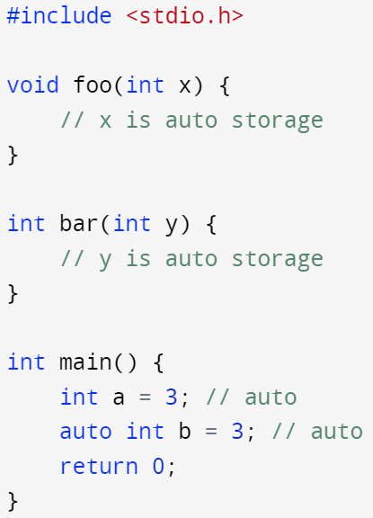
Storage duration - automatic
Automatic storage duration:
The storage is allocated when the block in which the object was declared is entered, and deallocated when it is exited by any means (goto, return, reaching the end). In other word, identifier in block scope has this automatic storage duration
If the block is entered recursively (e.g., recursive function call), a new allocation is performed for every recursion level
All function parameters and non-static block-scope objects have this storage duration as default

Slide 7
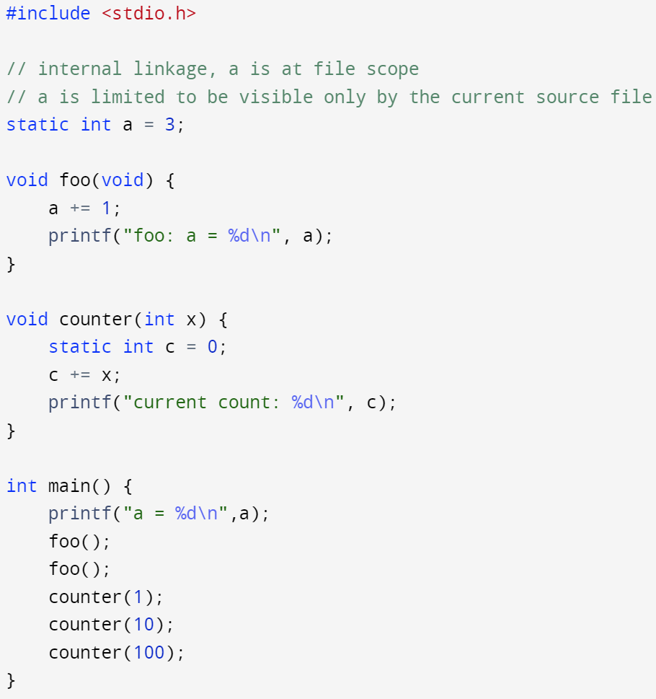
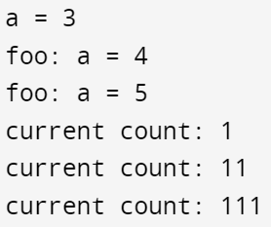
Storage duration - static
Static storage duration:
the storage duration is the entire execution of the program. It allows you to make local variables maintain their values between function calls.
the value stored in the object is initialized only once, prior to the main function
Static variable’s default value is 0 if no initialization value is given in its declaration

Slide 8
Storage duration – extern
Thread storage duration:
Lifetime is the entire execution of the thread
Allocated storage duration:
The storage is allocated and deallocatyed on request, using dynamic memory allocation functions
Malloc()
Calloc()

Slide 9
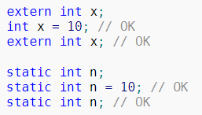


Redeclaration – rules simplify usage of header files
A declaration cannot introduce an identifier if another declaration for the same identifier in the same scope appears earlier, except that
Declarations of the objects with linkage (external or internal) can be repeated
typedef can be repeated as long as it names the same type
Struct and union declarations can be repeated
A type may have multiple aliases, an alias can only be defined for one type
We’ve seen this when introducing struct, declare first, then define with actual member list

Slide 10
Linkage
Linkage refers to the ability of an identifier (variable or function) to be referred to in other scopes. There are 3 kinds of linkages
No linkage
Internal linkage
External linkage

Slide 11
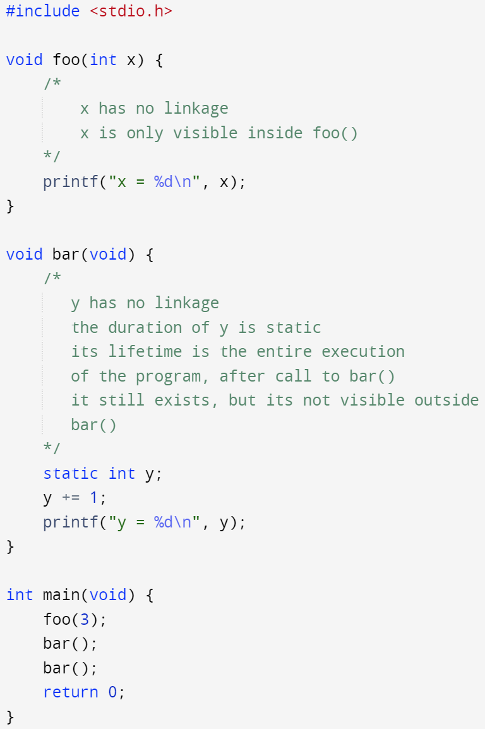

Linkage – no linkage
No linkage:
The identifier can be referred to only from the scope it is in.
All function parameters and all non-extern block-scope variables (including the ones declared as static) have this linkage

Slide 12
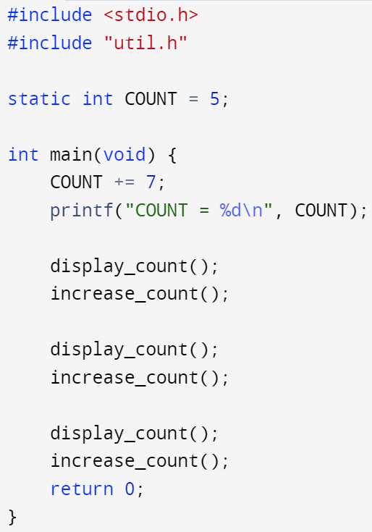
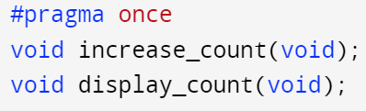
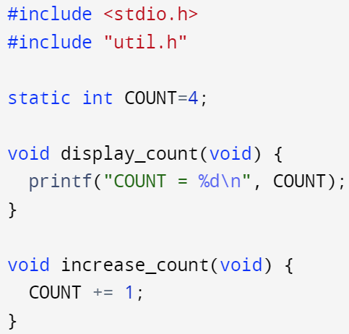
Linkage – internal linkage
Internal linkage:
the identifier can be referred to from all scopes in the current translation unit (visibility is limited to the current translation unit only even if it’s a part of a bigger multi-file program)
All static file scope identifiers (both functions and variables) have this linkage
main.c
util.h
12
util.c
4
5
6

Slide 13
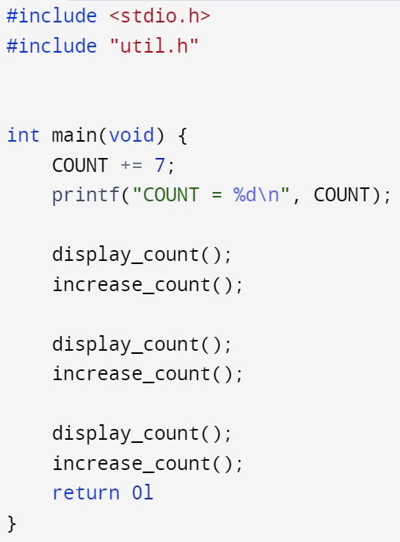
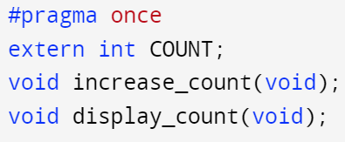
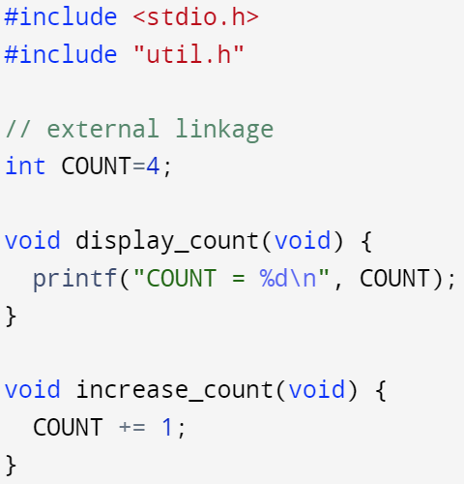
Linkage – external linkage
External linkage:
The identifier can be referred to from any other translation units in the entire program
All non-static functions, all extern variables (unless earlier declared static, i.e., redeclaration), and all file-scope non-static variables have this linkage
File scope identifiers, unless explicitly declared with static, are external linkage by default
main.c
util.h
11
util.c
11
12
13

Slide 14
Storage-class specifiers
Storage-class specifiers appear in declarations. At most one specifier may be used (except _Thread_local may be combined with static or extern to adjust linkage since C11)
The storage-class specifiers determine two independent properties of the names they declare: storage duration and linkage:
Storage-class specifiers | Storage duration | linkage | Properties & limits
auto | automatic | no linkage | Only allowed for objects at block scope, function scope (excluding function param list)
register | automatic | no linkage | Only allowed for objects at block scope, function scope (including function param list). It suggests the optimizer to store the value of this variable in a CPU register if possible. Regardless of this optimization take place or not, variables declared register cannot be used as operand to the address-of operator (&), and register array are not convertible to pointers
static | static | internal linkage | It can be used with functions at file scope and objects at both file and block scope
extern | static | external linkage | It can be used with functions and objects declarations in both file and block scope (excluding function parameter lists)
_Thread_local (C11) | thread storage duration | internal / external linkage | It can not be used with function declarations. If it is used on a declaration of an object, it must be present on every declaration of the same object. If its used on a block-scope declaration, it must be combined with either static or extern to decide linkage

Slide 15
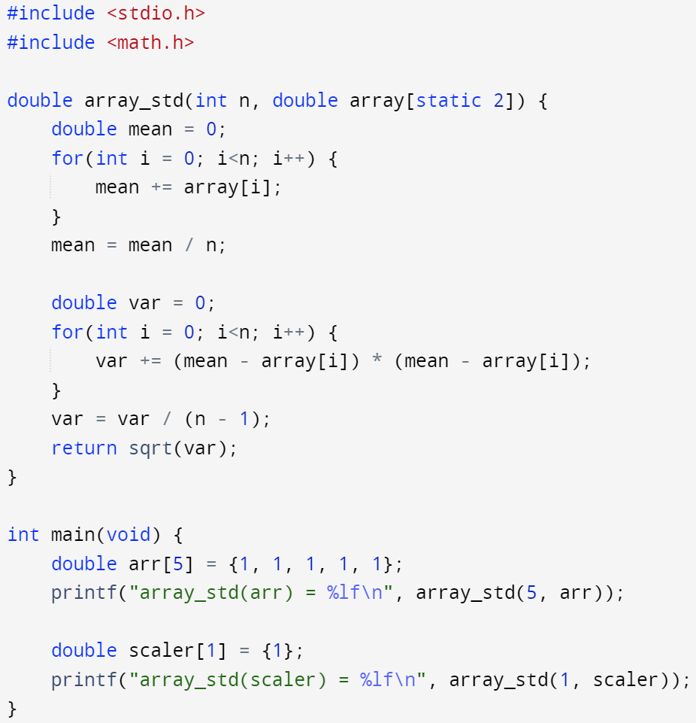
Storage-class specifiers
This tells the compiler that it should assume the array passed to array_std() has at least 2 elements -> otherwise, issue warning messages during compilation
Note: the warning message is not a feature required by the standard for all compilers, in this case, gcc doesn’t make any complaints, but clang does
If no storage-class specifier is provided, the defaults are:
extern for all functions -> functions have external linkage by default
extern for objects at file scope
auto for objects at block scope
For any struct or union declared with a storage-class specifier, the storage duration (but not linkage) applies to their members recursively
Function declarations at block scope can use extern or none at all. Functions declarations at file scope can use extern or static
Function parameters cannot use any storage-class specifiers other than register. Note that static has special meaning in function parameters of array type

